Slide 1


Classification
Stepwise Guide

Slide 2


Dataset
Using AdsApproval Dataset
To Predict if the ad is approved or not.

Slide 3
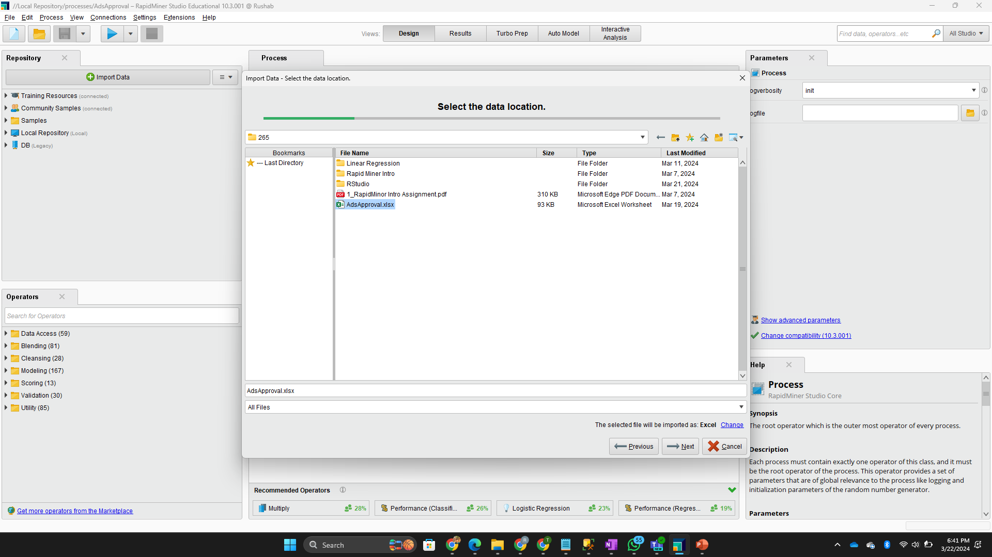




Importing Data
Click on the Import Data Icon on right.
In the pop-up dialog box find your file and click on next then next again.

Slide 4
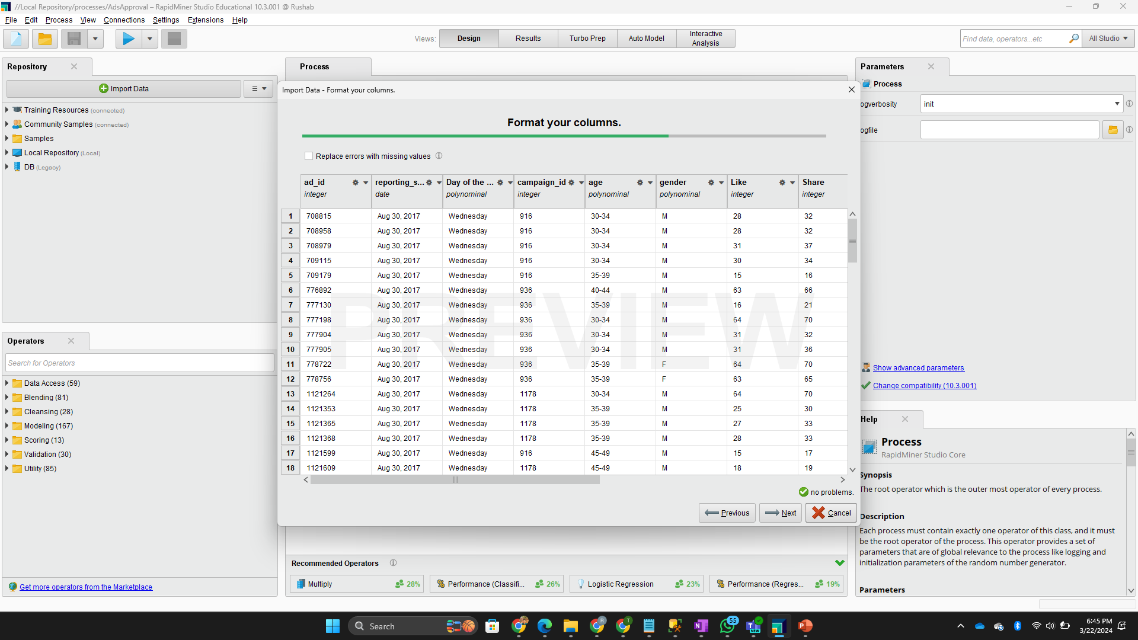



Importing Data continued…
For a machine it is easier to calculate using 0s and 1s like humans.
So, we convert the attributes to polynomials or binomials depending on the content.

Slide 5
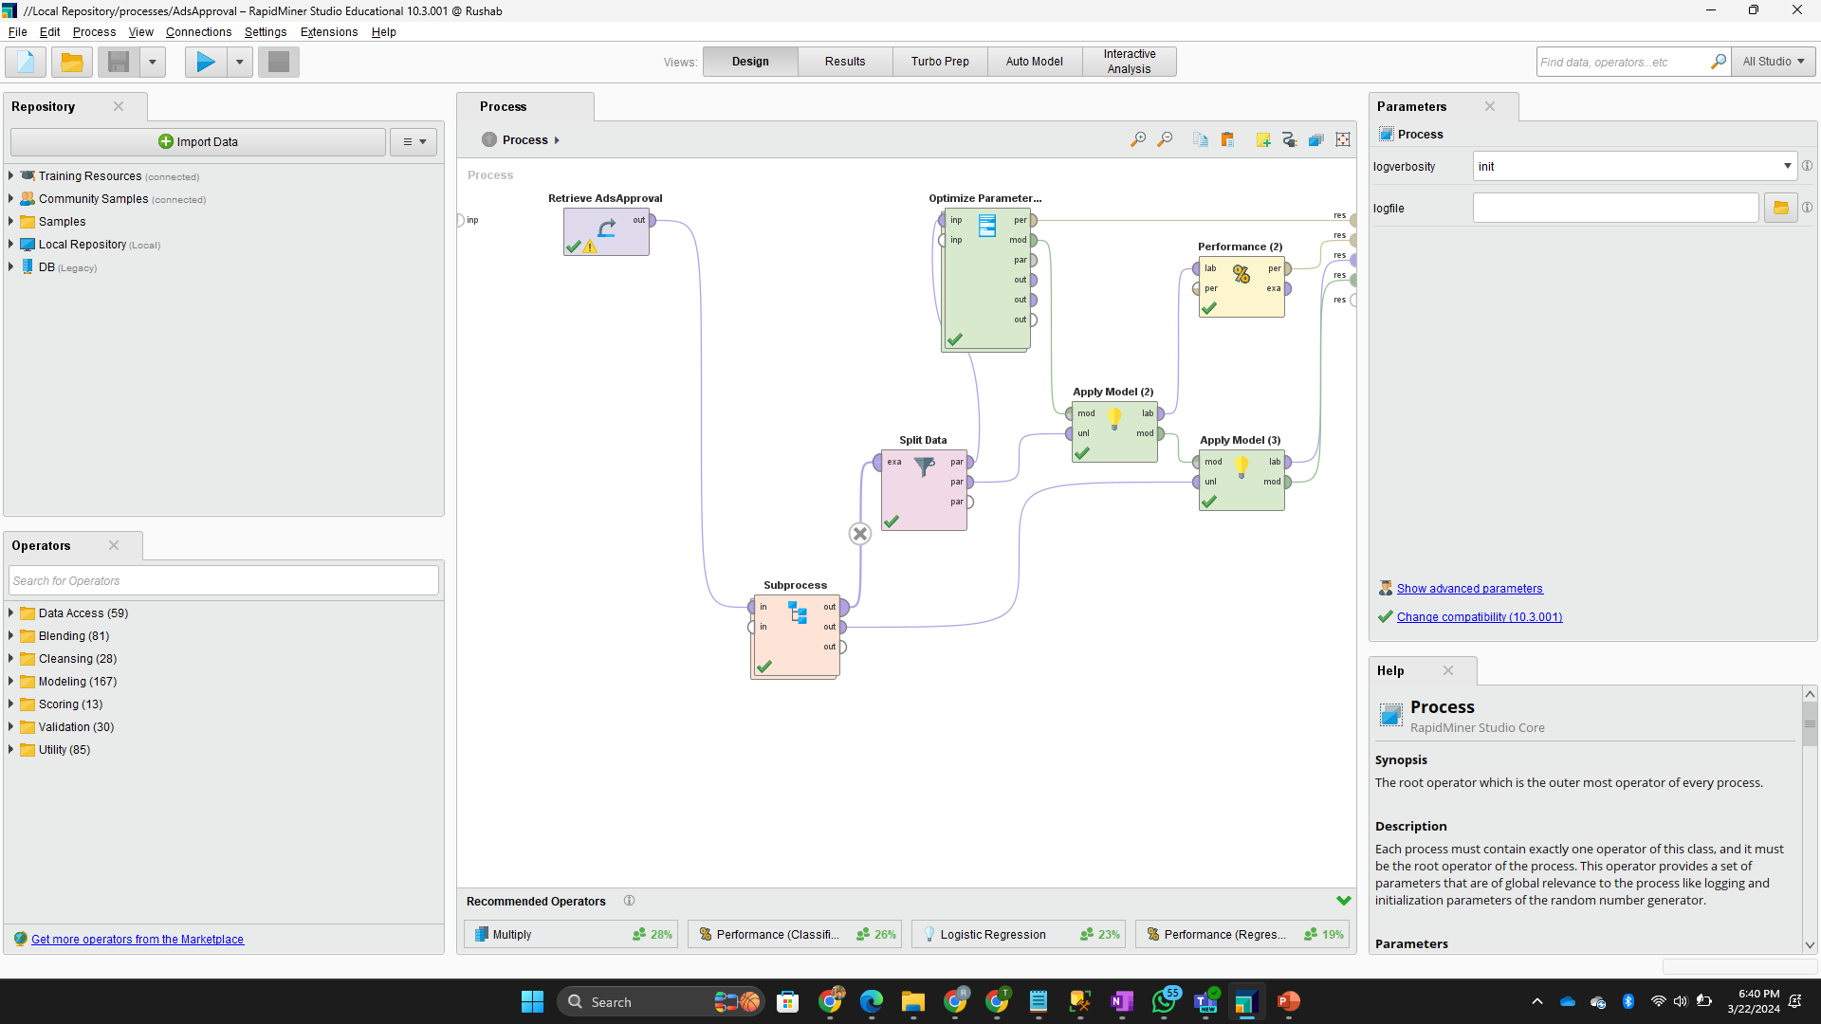



Retrieve the Data and add Subprocess
We can either add the Retrieve operator and then add our file or directly drag our file from the Repository to the process pane.
Then we add a subprocess operator to fill in a part of process into it.

Slide 6
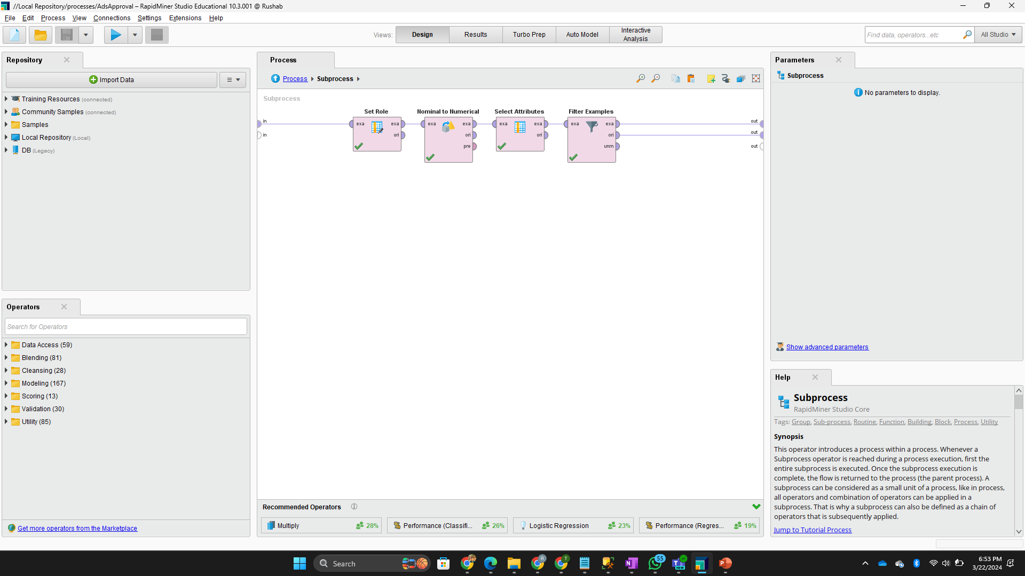


Adding a Subprocess
Double Click on the Subprocess Operator we added.
In this Subprocess add the required attributes. Refer to the screenshot on the left.
Set Role: Set “Approved” as Label (To be predicted)
Nominal to Numerical: Converting Nominal attributes to Numerical.
Select Attribute: Excluded not needed attributes.
Filter Examples: Filtering the Missing Values.

Slide 7
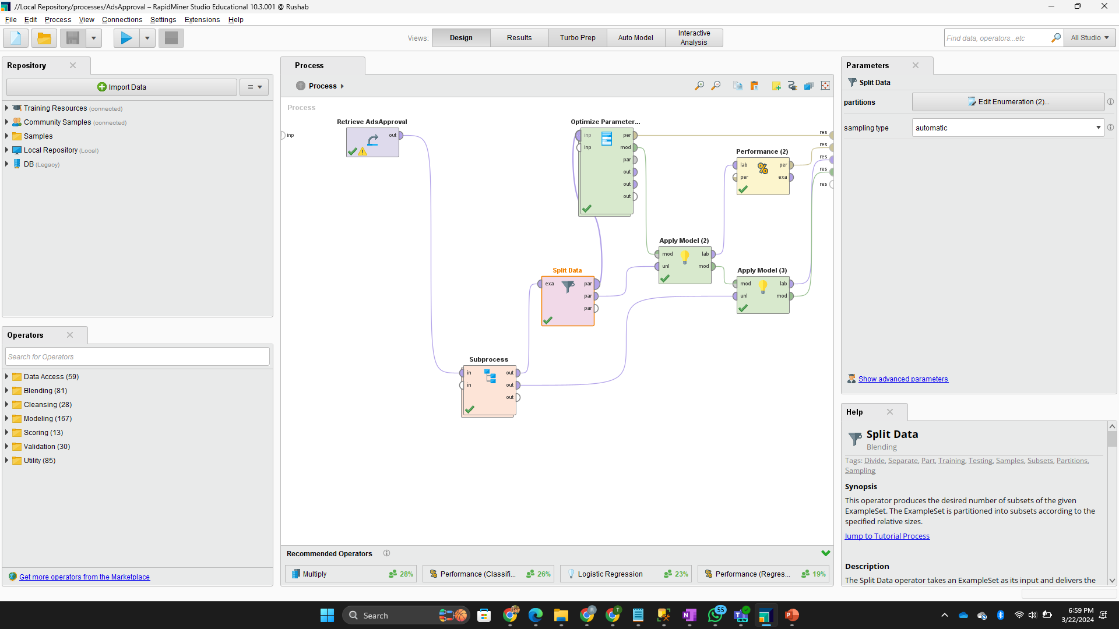



Splitting Data
Now let’s split the data for Training (80%) and Testing(20%).
We will put the training data into Optimize Parameter Operator for Cross Validation.

Slide 8
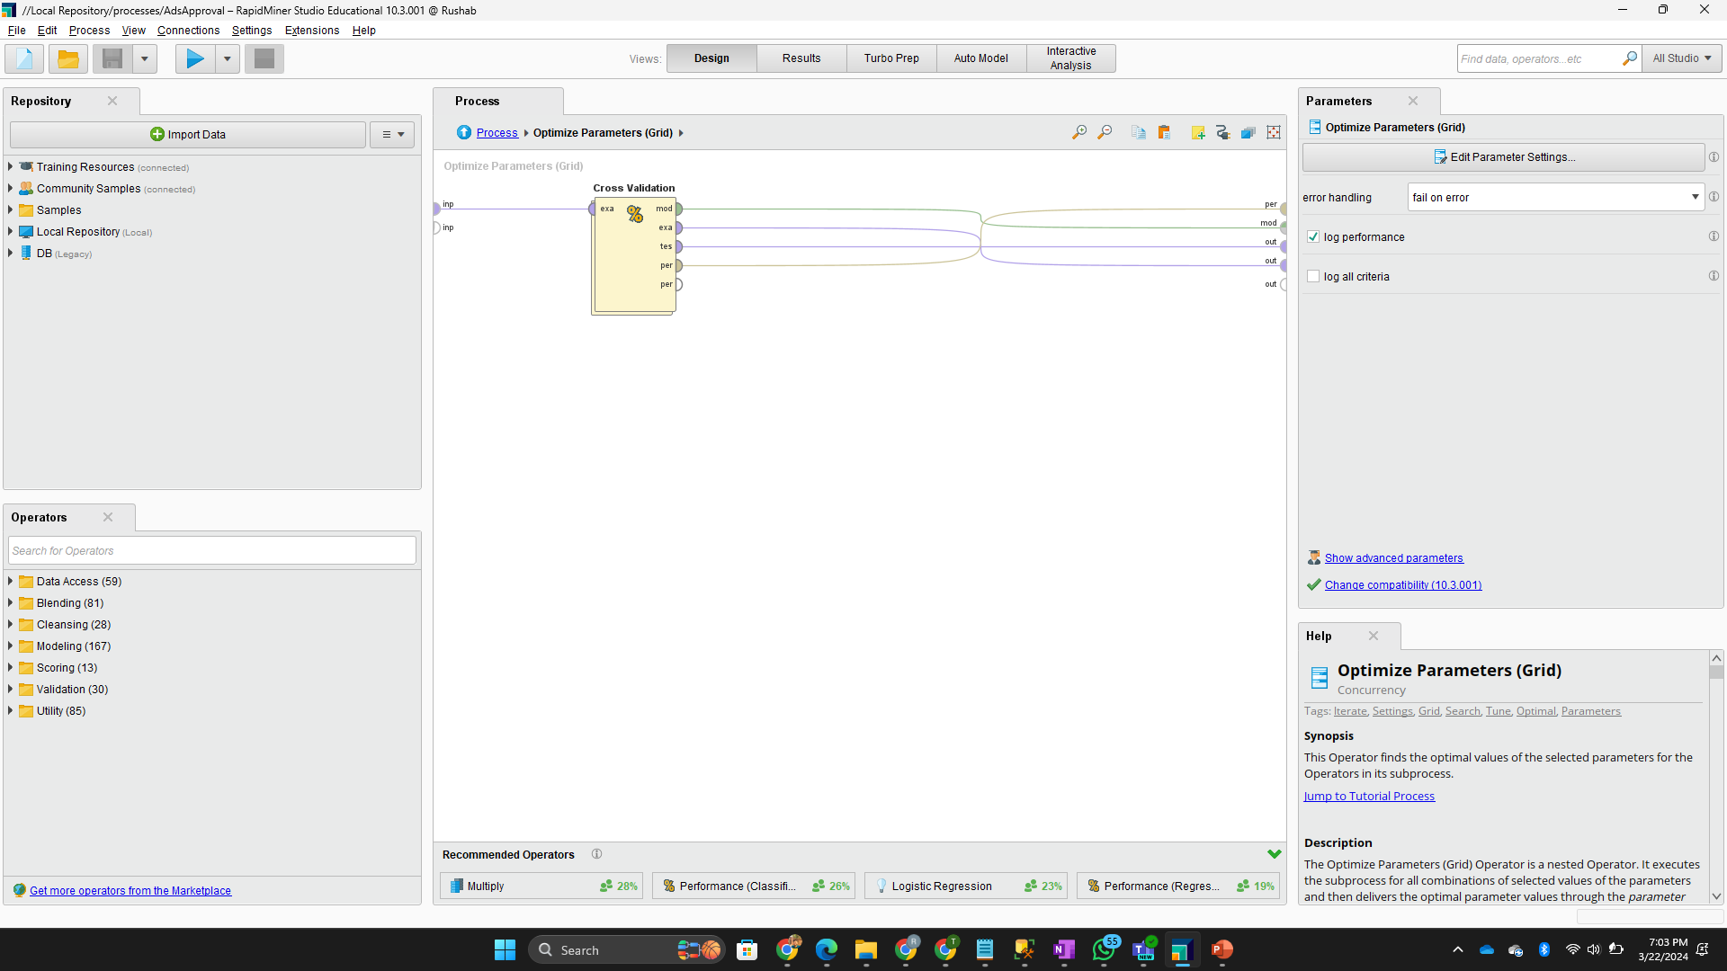



Optimize Parameter Grid
In Optimize Parameter we put in Cross Validation for Training

Slide 9
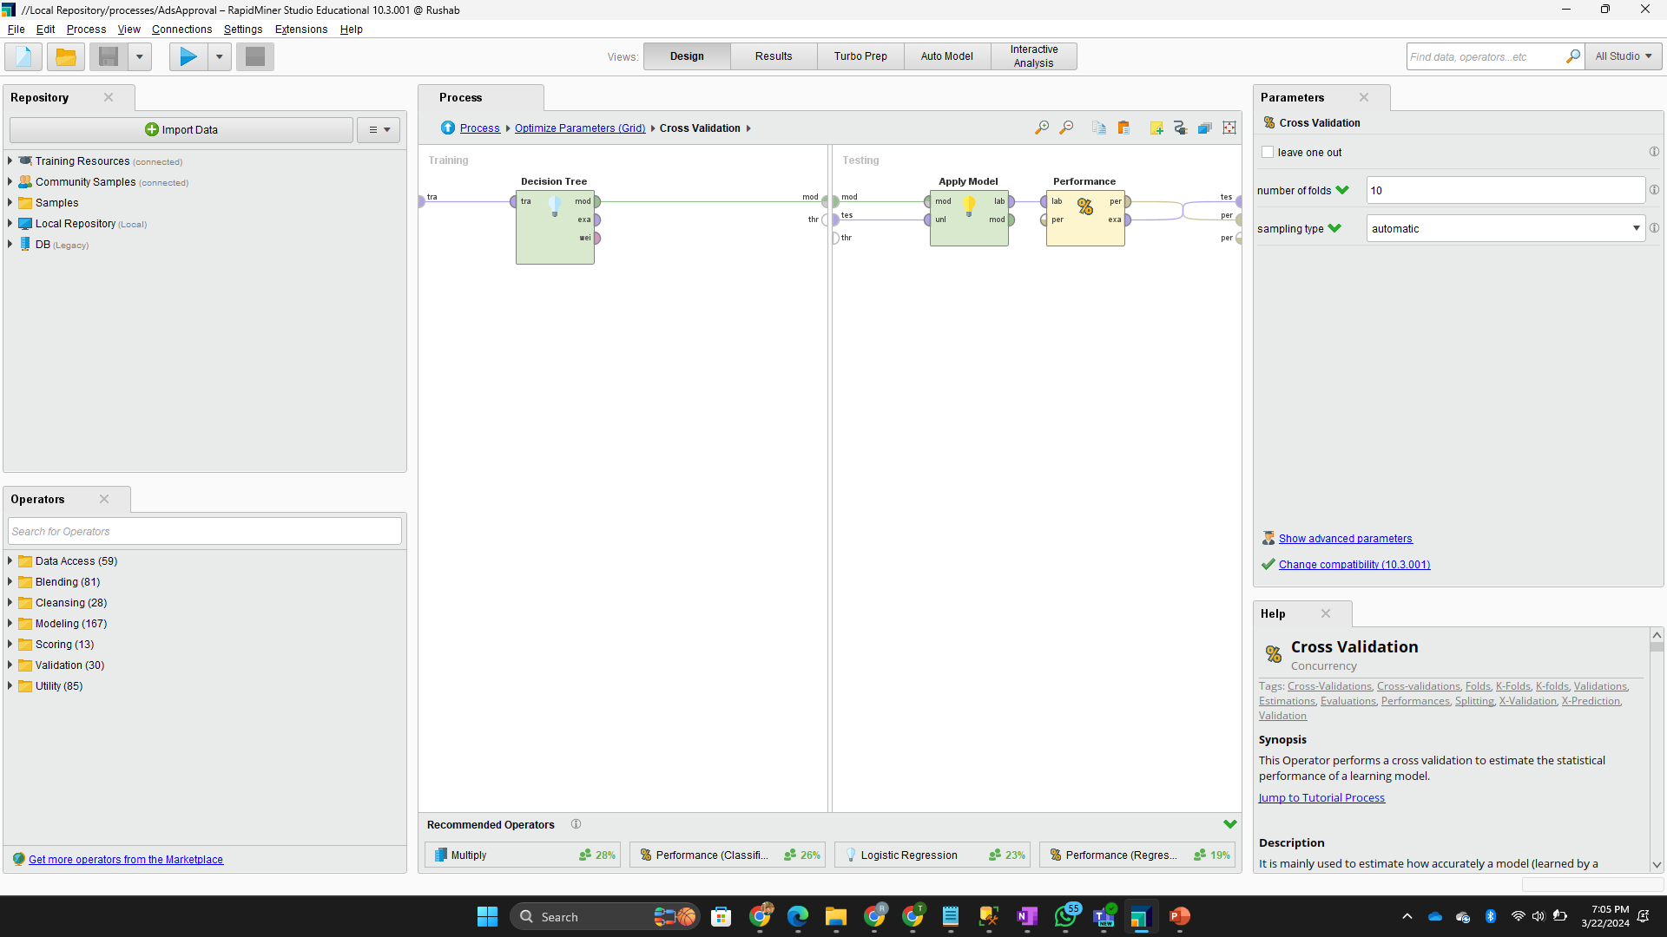
Cross Validation
In cross-validation, we add a Decision Tree in the Training and Apply Model and Performance (Binomial Classification) in Testing.
In Performance we add in parameters like accuracy, classification error, precision, false positive, false negative, true positive, true negative, sensitivity, and specificity.

Slide 10

Apply Model and Performance
Coming back to the Process, we drag in Apply Model for Training and Testing Both and similarly, Performance with same parameters and connect all connections properly.

Slide 11
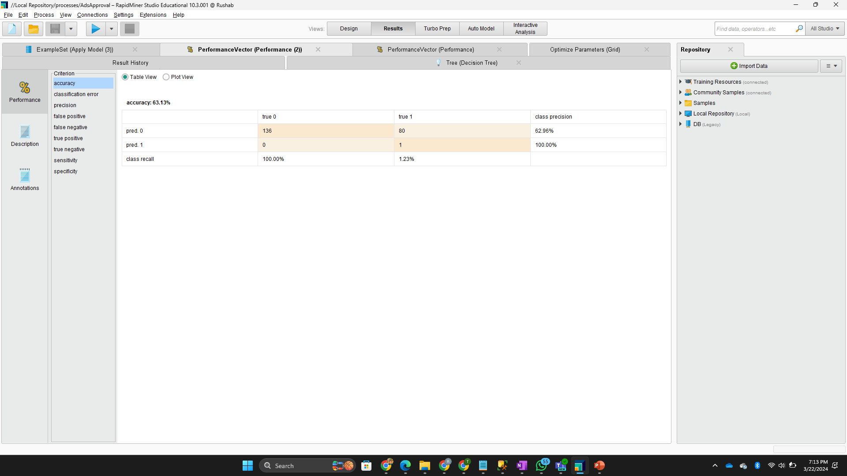
RESULT
This is the result screen with Performance for Training and Testing, Decision Tree, and more.

Slide 12

Thank You!

